Slide 1
Policy Roundtable
Unlocking growth: How financial tools can fuel EU clean tech leadership

Slide 2
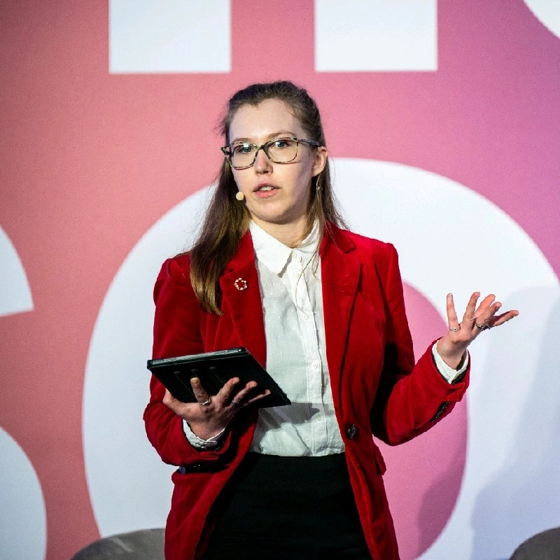
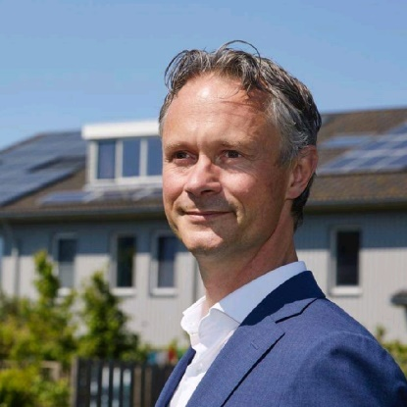
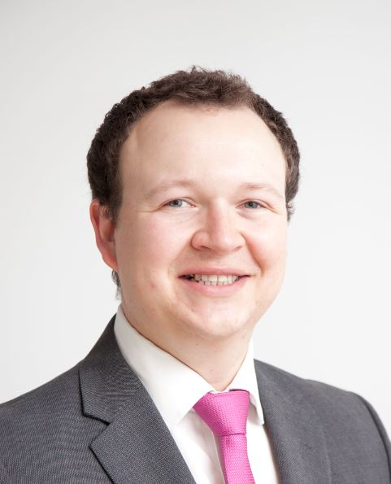
Speakers
Kira Taylor
Freelance climate & energy journalist
Olof van der Gaag
Chairman Dutch Association of Sustainable Energy (NVDE)
Phil Cole
Director of Industrial Affairs Wind Europe

Slide 3
How monetary policy tools can accelerate renewable energy & clean tech
Olof van der Gaag

Slide 4
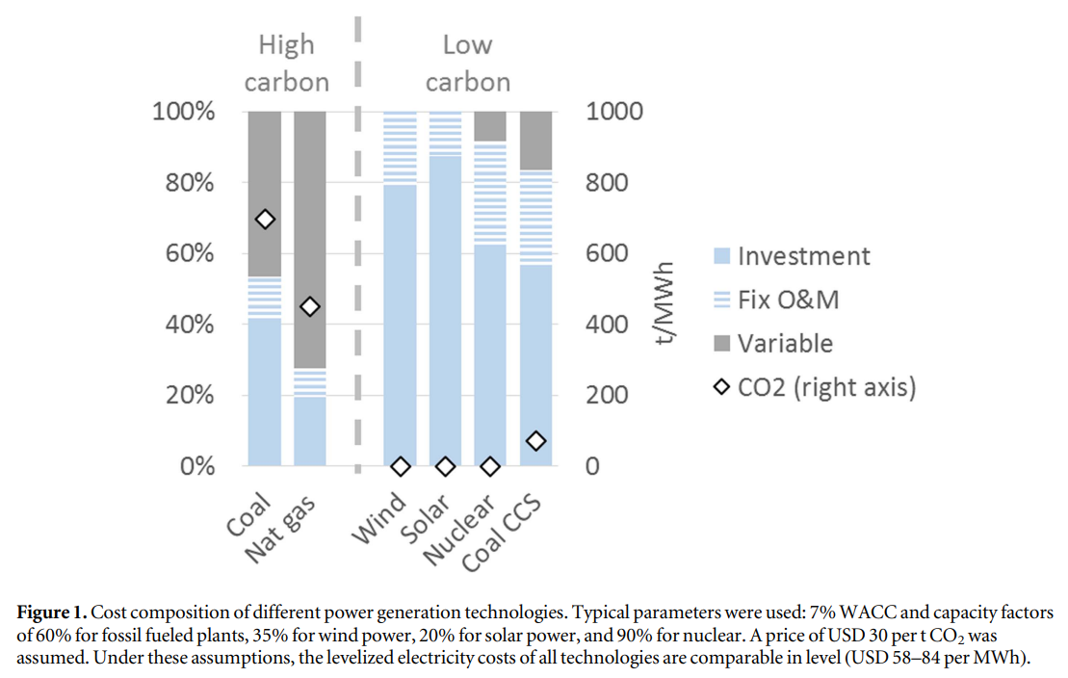
Cost composition of different power generation technologies
Source: Hirth & Steckel, 2016

Slide 5
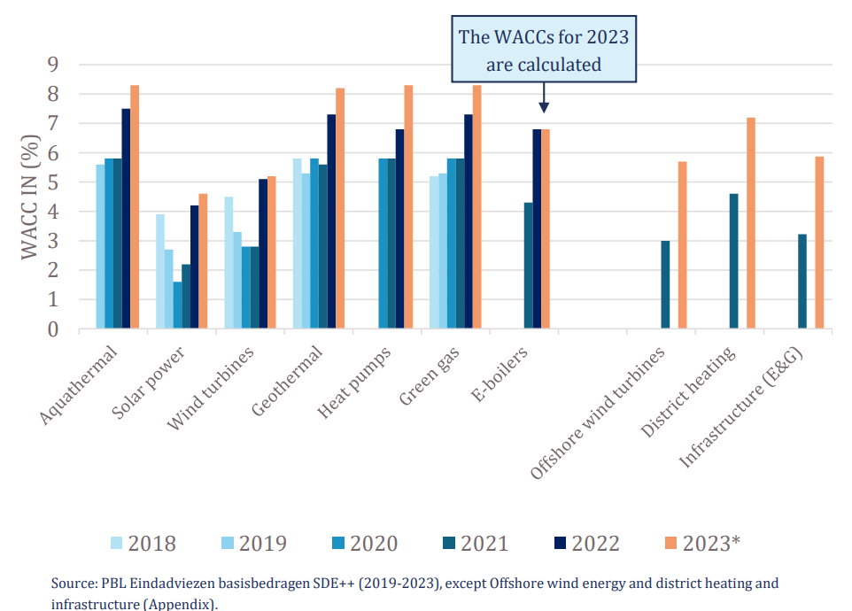
Rising interest rates have a large effect on financing costs
Source: Berenschot, 2023

Slide 6
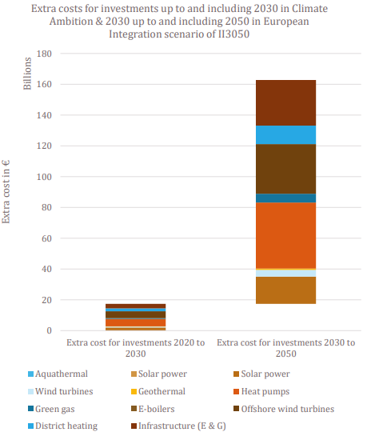
Interest rate rises will result in additional costs of EUR 163 billion up to and including 2050, and possibly delay the energy transition
Source: Berenschot, 2023

Slide 7
Impacts of high interest rates:
Significant deterioration of the businesscase
More subsidy pressure
Less attractiveness for investors
Source: Berenschot, 2023

Slide 8
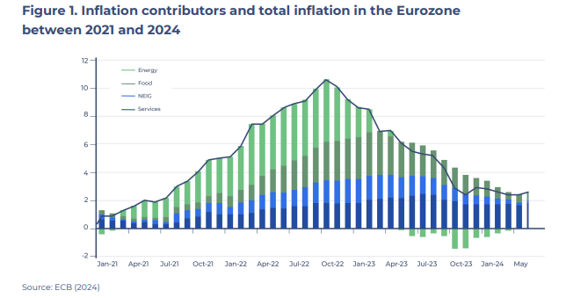
Fossil fuel prices were a large cause of high inflation
Source: Sustainable Finance Lab, 2024

Slide 9
Mandates European Central Bank
Primary mandate: Preserve price stability in the euro area by steering the short-term interest rate of the banking sector
Secondary mandate: The ECB shall support the general economic policies in the Union with a view to contributing to the achievement of the objectives of the Union.

Slide 10

A lower interest rate for renewable energy could help curb inflation
Green Targeted Longer-Term Refinancing Operations (TLTRO’s)
EU Taxonomy as a way to define ‘green lending’

Slide 11
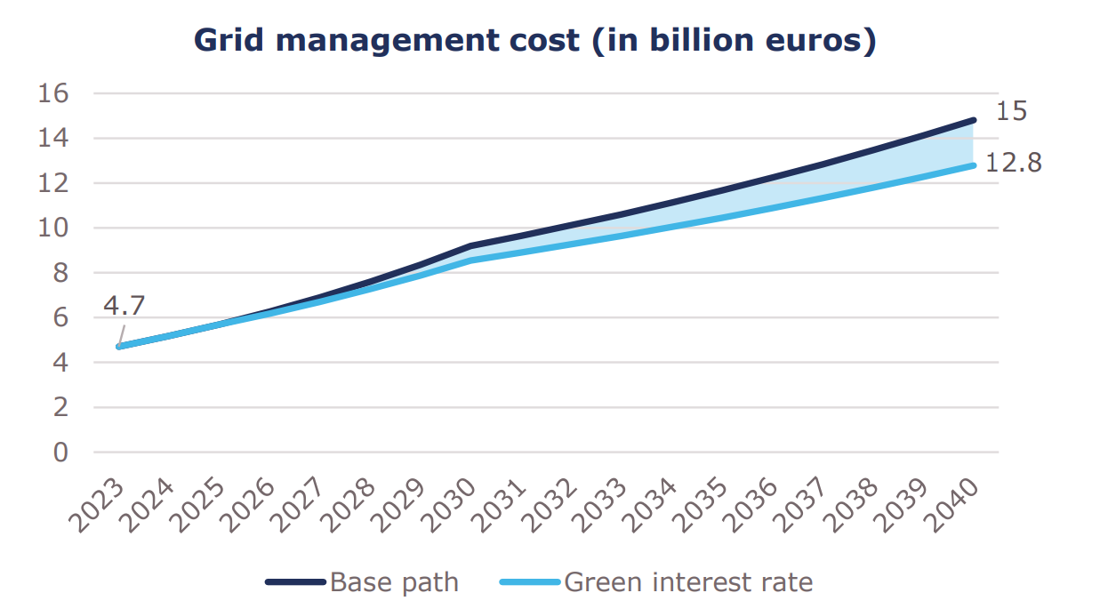
A green interest rate could save the Netherlands 15 billion euros on grid costs

Slide 12
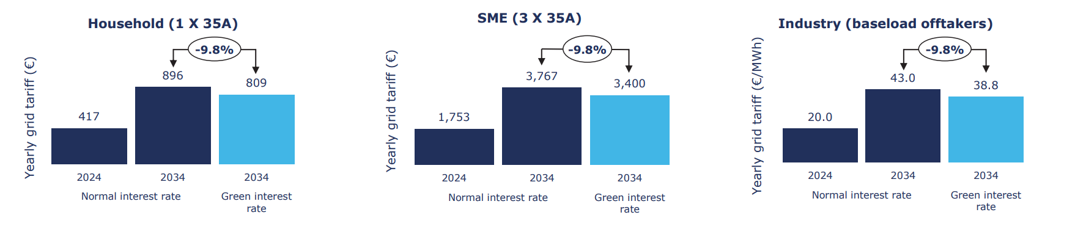
A green interest rate could save the Netherlands 15 billion euros on grid costs

Slide 13
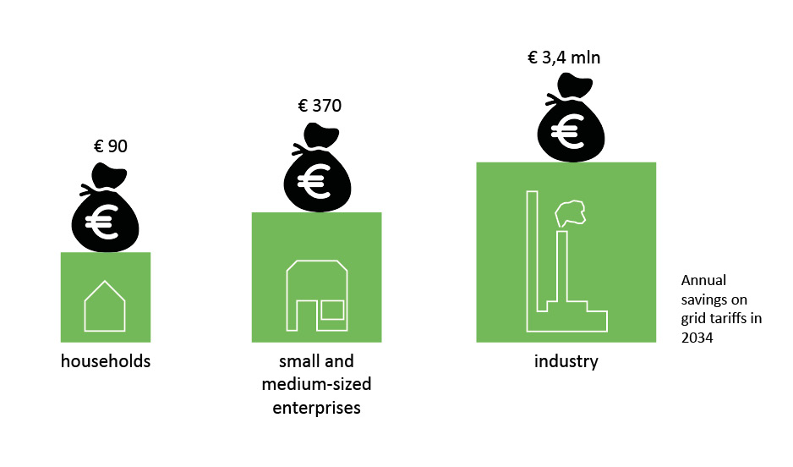
A green interest rate could save the Netherlands 15 billion euros on grid costs

Slide 14
Olof van der Gaag:
olofvandergaag@nvde.nl
Q&A

